Slide 1
Price Discrimination
Reference. Pindyck & Rubinefeld
J. Trole

Slide 2
Price discrimination
Practice of charging different prices to different consumers for similar goods.
Remarks:
Delivery prices may differ across consumers but that should not be regarded as price discrimination. It may reflect different transport cost.
Price discrimination may depend on the rate of consumption of a particular buyer.
Price discrimination may happen in case of product differentiation.
Price discrimination is feasible only when arbitrage between consumers can be prevented.

Slide 3
How can arbitrage be prevented?
High transaction cost may prevent arbitrage.
Product differentiation is an instrument for preventing arbitrage when transaction cost is low.

Slide 4
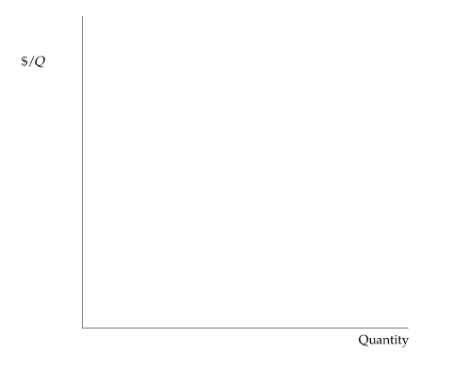
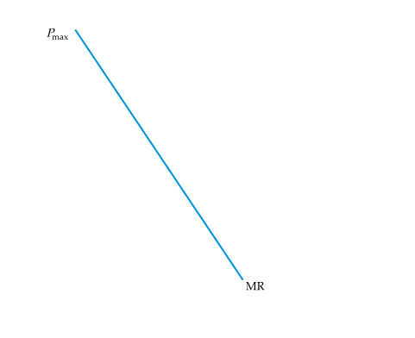
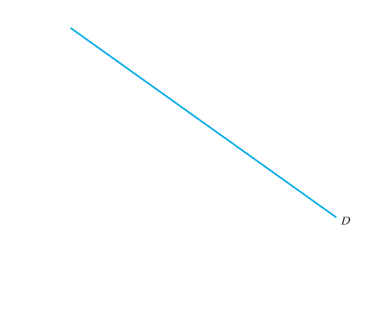
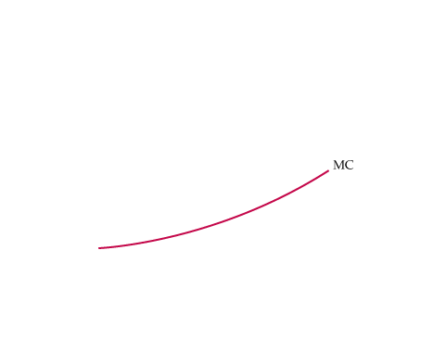

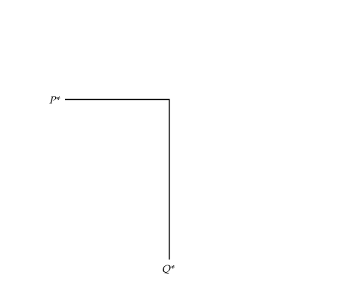
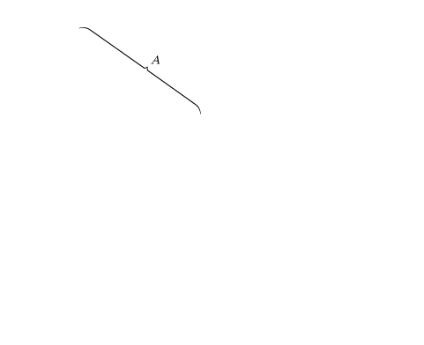
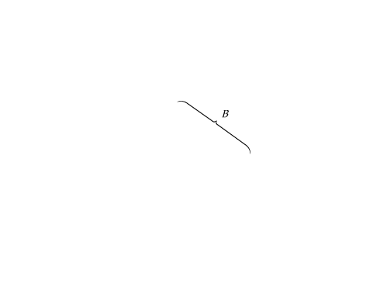


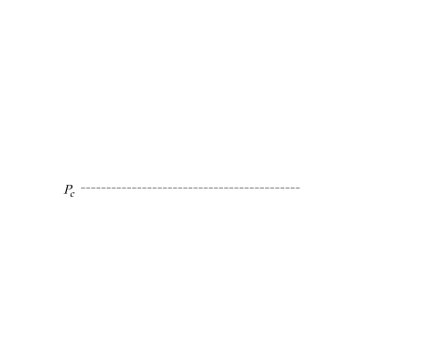
CAPTURING CONSUMER SURPLUS
If a firm can charge only one price for all its customers, that price will be P* and the quantity produced will be Q*.
Ideally, the firm would like to charge a higher price to consumers willing to pay more than P*, thereby capturing some of the consumer surplus under region A of the demand curve.
The firm would also like to sell to consumers willing to pay prices lower than P*, but only if doing so does not entail lowering the price to other consumers.
In that way, the firm could also capture some of the surplus under region B of the demand curve.
●

Slide 5


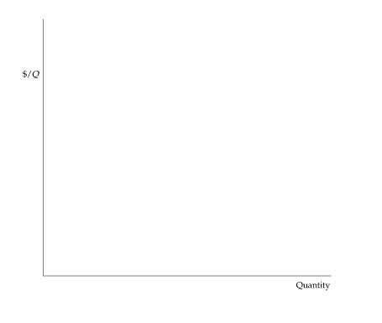
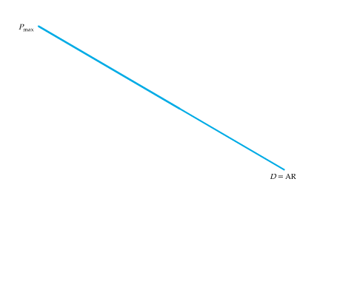
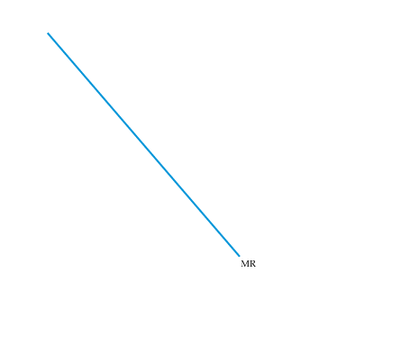
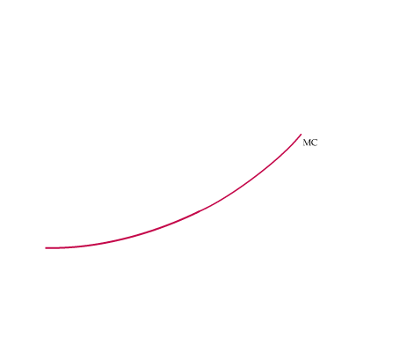
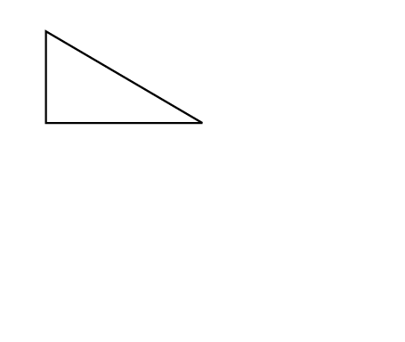
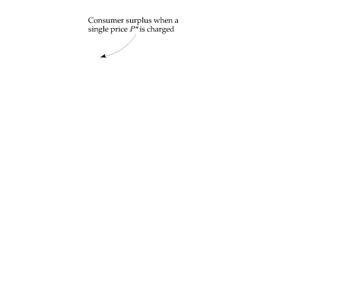

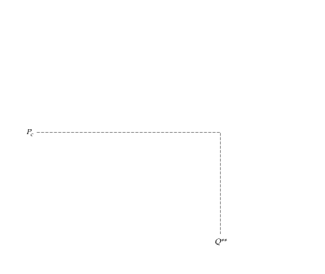
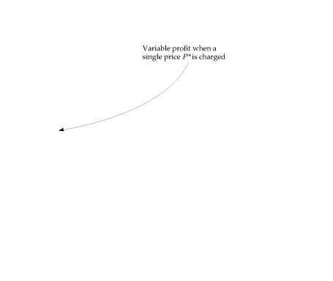
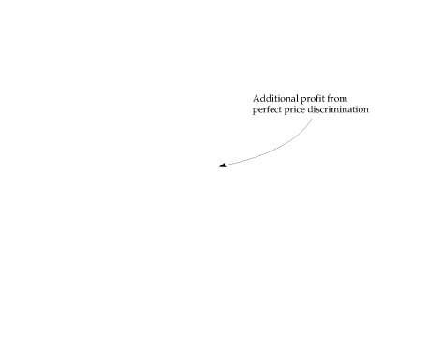
First-Degree Price Discrimination
Practice of charging each customer her reservation price.
● reservation price Maximum price that a customer is willing to pay for a good.
Additional Profit from Perfect First-Degree
Price Discrimination
Because the firm charges each consumer her reservation price, it is profitable to expand output to Q**.
When only a single price, P*, is charged, the firm’s variable profit is the area between the marginal revenue and marginal cost curves.
With perfect price discrimination, this profit expands to the area between the demand curve and the marginal cost curve.
● variable profit Sum of profits on each incremental unit produced by a firm; i.e., profit ignoring fixed costs.

Slide 6
Each unit is charged the price p(q) which is the maximum willingness-to-pay price.
Results.
Since the monopolist extracts all the surplus, consumer surplus is nil.
Output produced will be the same as the competitive output.
There will be no deadweight loss and thus like perfect competition, perfect price discrimination will be efficient.

Slide 7
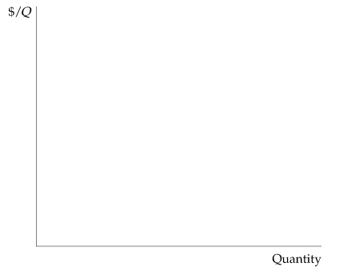
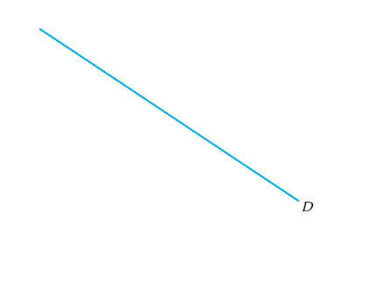
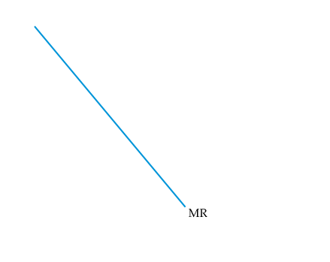
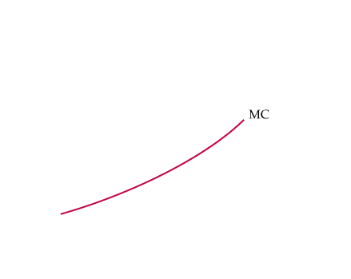



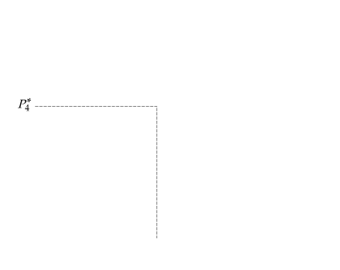
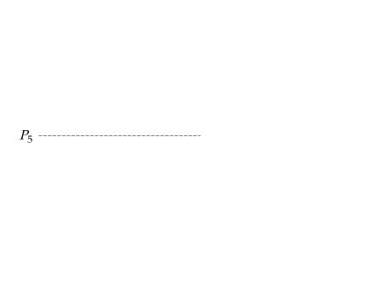
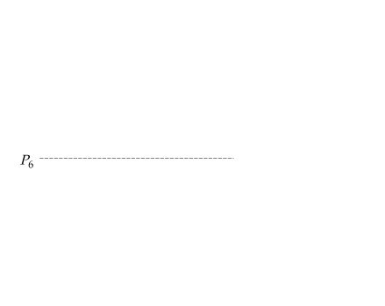
Perfect Price Discrimination
The additional profit from producing and selling an incremental unit is now the difference between demand and marginal cost.
Imperfect Price Discrimination
First-Degree Price Discrimination in Practice
Firms usually don’t know the reservation price of every consumer, but sometimes reservation prices can be roughly identified.
Here, six different prices are charged. The firm earns higher profits, but some consumers may also benefit.
With a single price P*₄, there are fewer consumers.
The consumers who now pay P₅ or P₆ enjoy a surplus.

Slide 8
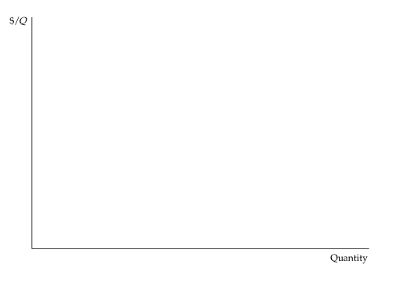
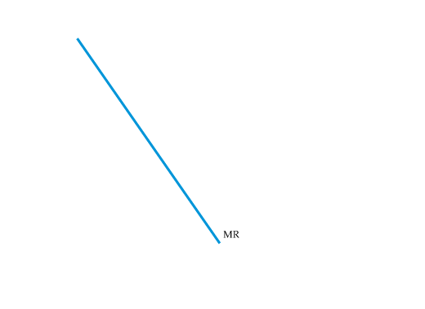
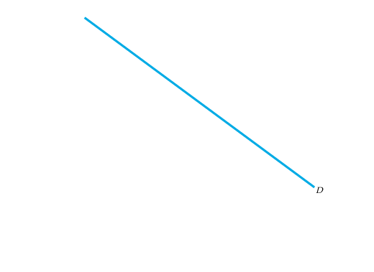
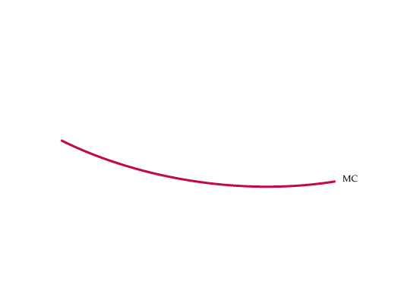
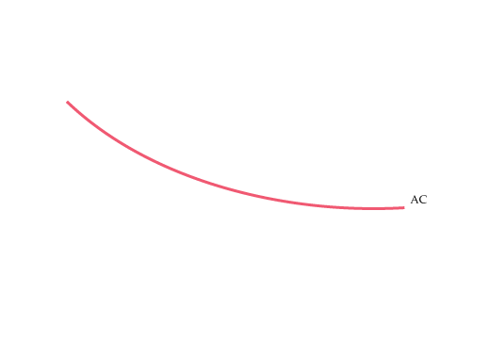
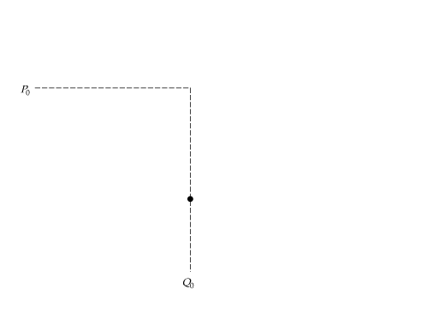
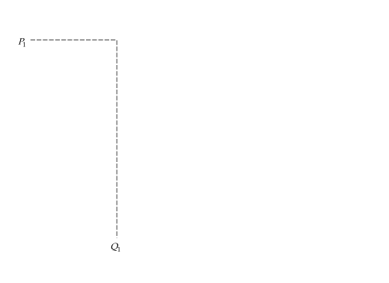

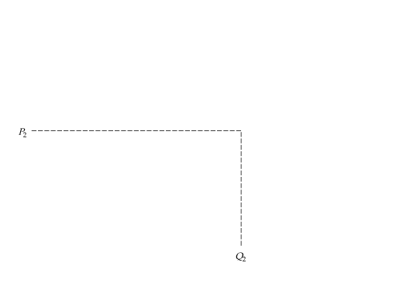
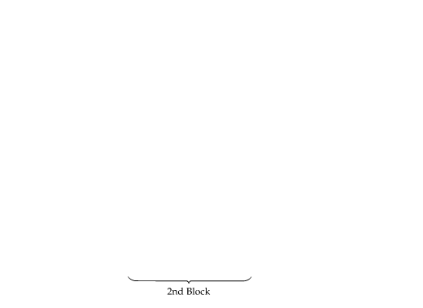
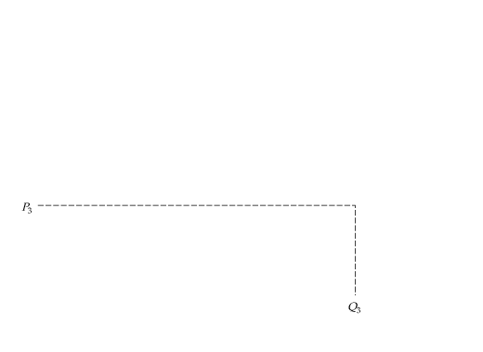
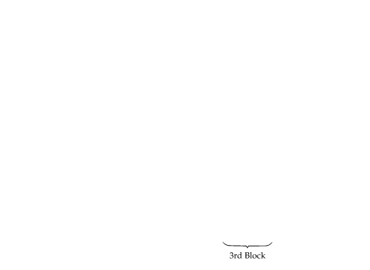
Second-Degree Price Discrimination
● Practice of charging different prices per unit for different quantities of the same good or service.
● block pricing Practice of charging different prices for different quantities or “blocks” of a good.
Second-Degree Price Discrimination
Different prices are charged for different quantities, or “blocks,” of the same good. Here, there are three blocks, with corresponding prices P₁, P₂, and P₃.
There are also economies of scale, and average and marginal costs are declining. Second-degree price discrimination can then make consumers better off by expanding output and lowering cost.

Slide 9
Third-Degree Price Discrimination
● Practice of dividing consumers into two or more groups with separate demand curves and charging different prices to each group.
Creating Consumer Groups
If third-degree price discrimination is feasible, how should the firm decide what price to charge each group of consumers?
1. We know that however much is produced, total output should be divided between the groups of customers so that marginal revenues for each group are equal.
2. We know that total output must be such that the marginal revenue for each group of consumers is equal to the marginal cost of production.

Slide 10







PRICE DISCRIMINATION
Third-Degree Price Discrimination
Creating Consumer Groups
(1)
Determining Relative Prices
(2)

Slide 11
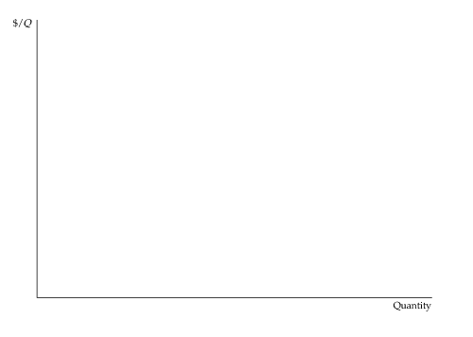
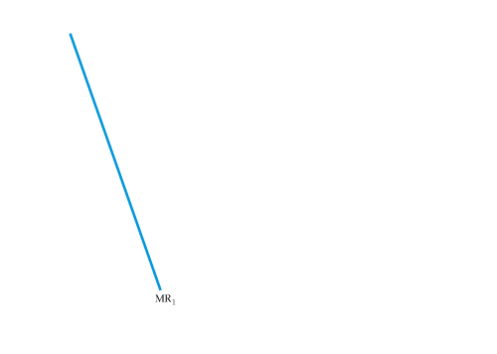
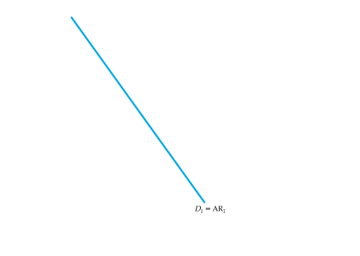
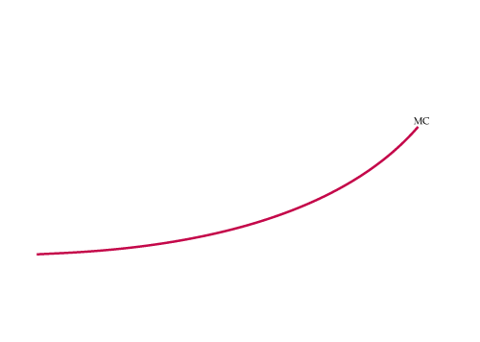
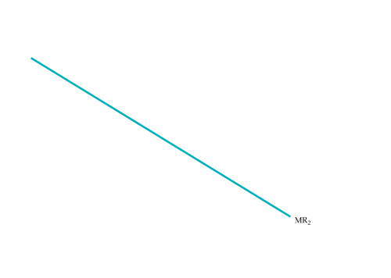
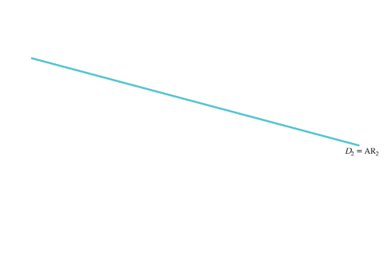

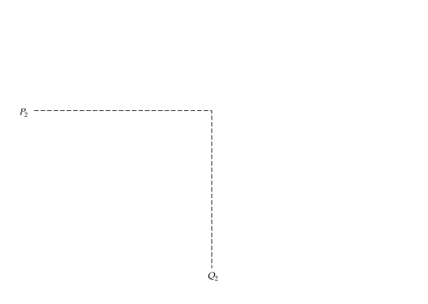
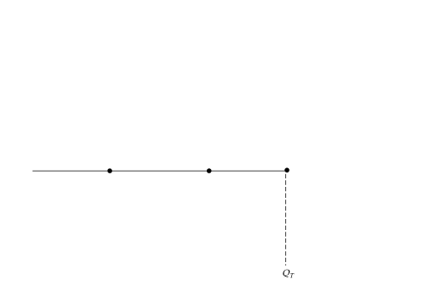
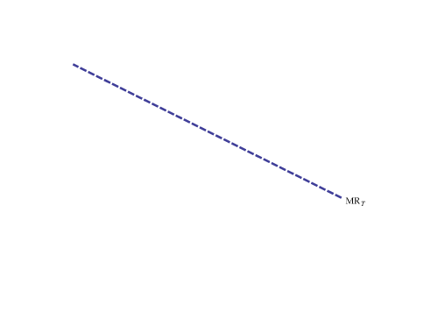
Third-Degree Price Discrimination
Third-Degree Price Discrimination
Consumers are divided into two groups, with separate demand curves for each group. The optimal prices and quantities are such that the marginal revenue from each group is the same and equal to marginal cost.
Here group 1, with demand curve D₁, is charged P₁,
and group 2, with the more elastic demand curve D₂, is charged the lower price P₂.
Marginal cost depends on the total quantity produced Q_{T}.
Note that Q₁ and Q₂ are chosen so that MR₁ = MR₂ = MC.

Slide 12
It is also known as multimarket discrimination.
iff
If
then
Output under third degree PD= Output under uniform pricing monopolist.

Slide 13
Pricing in practice
Tying
Bundling
Two-part Tariff
Peak Load Pricing/Intertemporal pricing

